Slide 1
Unit-5
Reinforcement Learning
Prepared By: Arjun Sing Saud
Asst. Prof. CSCSIT, TU

Slide 2
Reinforcement Learning
In a typical Reinforcement Learning (RL) problem, there is a learner and a decision maker called agent and the surrounding with which it interacts is called environment.
The environment, in return, provides rewards and a new state based on the actions of the agent.
So, in reinforcement learning, we do not teach an agent how it should do something but presents it with rewards whether positive or negative based on its actions.

Slide 3
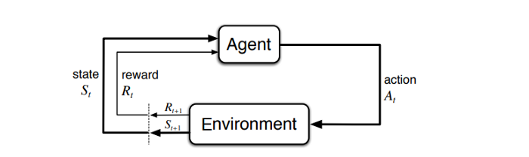
Reinforcement Learning

Slide 4
Terminologies Related to RL
State
This is the position of the agents at a specific time-step in the environment. So, whenever an agent performs a action the environment gives the agent reward and a new state where the agent reached by performing the action.
Markov Property
The Markov property means that evolution of the Markov process in the future depends only on the present state and does not depend on past history. The Markov process does not remember the past if the present state is given. Hence, the Markov process is called the process with memory-less property.

Slide 5

Terminologies Related to RL
State Transition Probability
We can define state Transition Probability as follows: For Markov State from S[t] to S[t+1] i.e. any other successor state , the state transition probability is given by
We can formulate the State Transition probability into a State Transition probability matrix by :

Slide 6
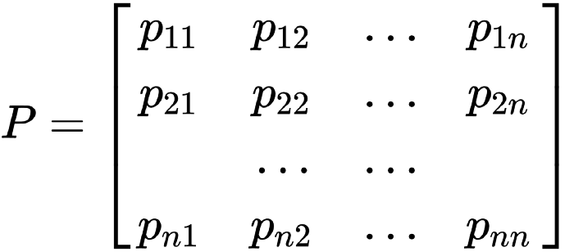
Terminologies Related to RL
Each row in the matrix represents the probability from moving from our original or starting state to any successor state. Sum of each row is equal to 1.

Slide 7
Terminologies Related to RL
Markov Process or Markov Chains
Markov Process is the memory less random process i.e. a sequence of a random state S[1],S[2],….S[n] with a Markov Property.
So, it’s basically a sequence of states with the Markov Property. It can be defined using a set of states(S) and transition probability matrix (P).
The dynamics of the environment can be fully defined using the States(S) and Transition Probability matrix(P).

Slide 8
Terminologies Related to RL
Reward and Returns
Rewards are the numerical values that the agent receives on performing some action at some state(s) in the environment.
The numerical value can be positive or negative based on the actions of the agent.
In RL, we care about maximizing the cumulative reward instead of, the reward agent receives from the current state.

Slide 9
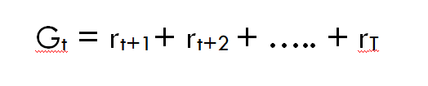
Terminologies Related to RL
Reward and Returns
This total sum of reward the agent receives from the environment is called returns. We can define Returns as :
r[t+i] is the reward received by the agent at time step t while performing an action a to move from one state to another.

Slide 10
Terminologies Related to RL
Discount Factor (ɤ)
It determines how much importance is to be given to the immediate reward and future rewards. This basically helps us to avoid infinity as a reward in continuous tasks. It has a value between 0 and 1.
A value of 0 means that more importance is given to the immediate reward and a value of 1 means that more importance is given to future rewards.

Slide 11

Terminologies Related to RL
Discount Factor (ɤ)
In practice, a discount factor of 0 will never learn as it only considers immediate reward and a discount factor of 1 will go on for future rewards which may lead to infinity. Therefore, the optimal value for the discount factor lies between 0.2 to 0.8.
So, we can define returns using discount factor as follows :

Slide 12
Markov Decision Process (MDP)
Almost all problems in Reinforcement Learning are theoretically modelled as maximizing the return in a Markov Decision Process, (MDP).
An MDP is characterized by 5-tuple (S,A,P, ^{γ},R):
S : The set of states that the agent experiences when interacting with the environment. The states are assumed to have the Markov property.
A : The set of legitimate actions that the agent can execute in the environment.

Slide 13
Markov Decision Process (MDP)
P : The transition function that gives the distribution over what states we will transition to if we take action A in state S.
R : The reward function that determines what reward the agent will get when it transitions from one state to another using a particular action.
𝛾 : 𝛾 is the discount factor.

Slide 14
Markov Decision Process (MDP)
The dynamics of an MDP proceeds as follows:
We start in some state s₀, and get to choose some action a₀ϵ A to take in the MDP. As a result of our choice, the state of the MDP randomly transitions to some successor state s₁.
Then, we get to pick another action a₁. As a result of this action, the state transitions again, now to some s₂.
We then pick a₂, and so on
Pictorially, we can represent this process as follows:

Slide 15
Markov Decision Process (MDP)
Upon visiting the sequence of states s₀, s₁,….. with actions a₀, a₁……., our total payoff is given by
OR
Our goal in reinforcement learning is to choose actions over time so as to maximize the expected value of the total payoff.

Slide 16
Markov Decision Process (MDP)
Note that the reward at time step t is discounted by a factor of 𝛾^{t}. Thus, to make this expectation large, we would like to accrue positive rewards as soon as possible (and postpone negative rewards as long as possible).

Slide 17

Value and Policy Functions
A policy is a simple function, that defines a probability distribution over Actions (a∈ A) for each state (s ∈ S).
If an agent at time t follows a policy π then π(a|s) is the probability that the agent with taking action (a ) at a particular time step (t).
In Reinforcement Learning the experience of the agent determines the change in policy. Mathematically, a policy is defined as follows

Slide 18
Value and Policy Functions
Value Function determines how good it is for the agent to be in a particular state.
Of course, to determine how good it will be to be in a particular state it must depend on some actions that it will take. This is where policy comes in.
The value of state s, when the agent is following a policy π which is denoted by v_{π}(s) is the expected return starting from s and following a policy π for the next states until we reach the terminal state.

Slide 19

Value and Policy Functions
We can formulate this as:
This equation gives us the expected returns starting from the state(s) and going to successor states thereafter, with the policy π.
One thing to note is the returns we get is stochastic whereas the value of a state is not stochastic.

Slide 20
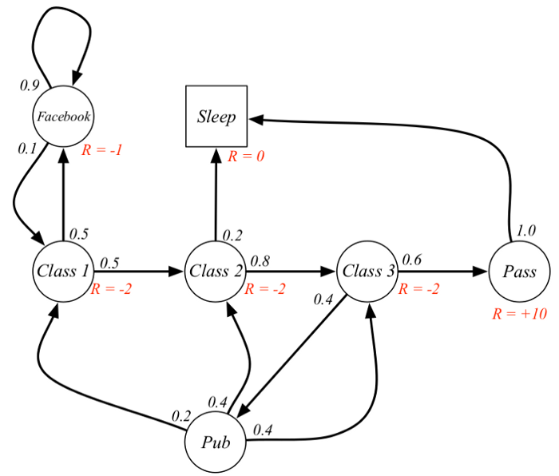
Value and Policy Functions
Let’s look at an example :
Suppose our start state is Class 2, and we move to Class 3 then Pass then Sleep.In short, Class 2 > Class 3 > Pass > Sleep.
Our expected return is with a discount factor of 0.5:
G_{t}=-2+(-2x0.5)+10x0.25 + 0

Slide 21
Value and Policy Functions
Bellman Equation helps us to find optimal policies and value functions. We know that our policy changes with experience so we will have different value functions according to different policies.
The optimal value function is one that gives maximum value compared to all other value functions.
Bellman Equation states that value function can be decomposed into two parts:
Immediate Reward, R[t+1]
Discounted value of successor states

Slide 22
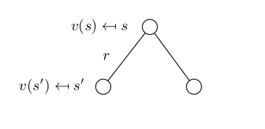
Value and Policy Functions
Mathematically, we can define Bellman Equation as :
Let’s understand what this equation says with a help of an example.

Slide 23

Value and Policy Functions
We want to know the value of state s. The value of state(s) is the reward we got upon leaving that state, plus the discounted value of the state we landed upon multiplied by the transition probability that we will move into it.
The above equation can be expressed in matrix form as follows :

Slide 24
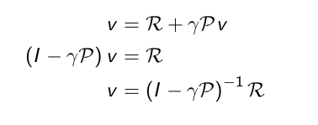
Value and Policy Functions
Where v is the value of state we were in, which is equal to the immediate reward plus the discounted value of the next state multiplied by the probability of moving into that state.
The running time complexity for this computation is O(n³). Therefore, this is clearly not a practical solution for solving larger MDPs.

Slide 25

State-action value function or Q-Function
This function specifies how good it is for the agent to take action (a) in a state (s) with a policy π. Mathematically, we can define the State-action value function or Q-function as :
OR

Slide 26
Bellman Expectation Equation
We know that Bellman Equation is given as below
From the above equation, we can see that the value of a state can be decomposed into immediate reward(R[t+1]) plus the value of successor state(v[S (t+1)]) with a discount factor( 𝛾).
But now what we are doing is we are finding the value of a particular state subjected to some policy(π).

Slide 27

Bellman Expectation Equation
This is the difference between the Bellman Equation and the Bellman Expectation Equation. Mathematically we can define Bellman Expectation Equation as:
First, let’s understand Bellman Expectation Equation for State-Value Function with the help of a backup diagram:

Slide 28
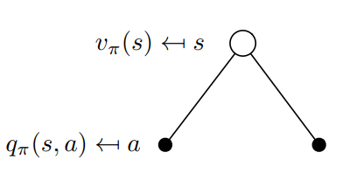
Bellman Expectation Equation
This backup diagram describes the value of being in a particular state. From the state s there is some probability that we take both the actions.
There is a Q-value for each of the action. We average the Q-values. Basically, it defines Vπ(s). Mathematically, we can define it as follows:

Slide 29
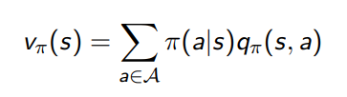
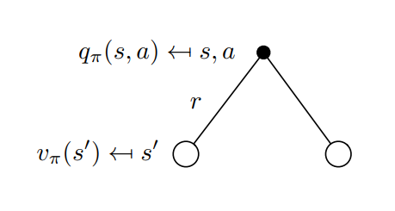
Bellman Expectation Equation
This equation also tells us the connection between State-Value function and Q-Function. Now, let’s look at the backup diagram for Q-value Function:

Slide 30
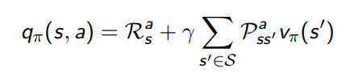
Bellman Expectation Equation
This backup diagram says that suppose we start off by taking some action(a). So, because of the action(a) the agent might be blown to any of these states by the environment.
We again average the state-values of both the states, added with an immediate reward which tells us how good it is to take a particular action(a).This defines q_{π}(s,a). Mathematically, we can define this as follows :

Slide 31
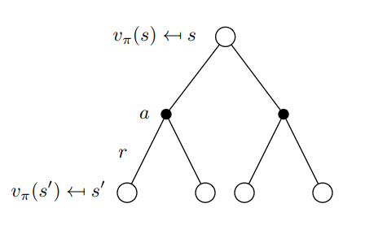
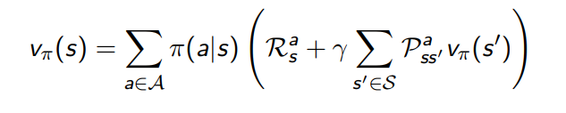
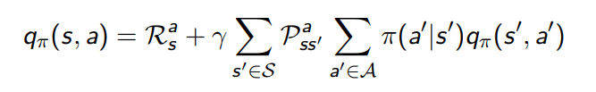
Bellman Expectation Equation
Now let’s stitch these backup diagrams together to define State-Value Function and Q-function:

Slide 32

Optimal Value and Policy Functions
In an MDP environment, there are many different value functions according to different policies.
The optimal Value function is one which yields maximum value compared to all other value function.
When we say we are solving an MDP it actually means we are finding the Optimal Value Function.
So, mathematically Optimal State-Value Function can be expressed as :

Slide 33

Optimal Value and Policy Functions
In the above formula, v∗(s) tells us what is the maximum reward we can get from the system.
Similarly, Optimal State-Action Value Function (or Q-function) tells us the maximum reward we are going to get if we are in state s and taking action a from there on-wards. Mathematically, It can be defined as :

Slide 34

Optimal Value and Policy Functions
We say that one policy(π) is better than other policy (π’) if the value function with the policy π for all states is greater than the value function with the policy π’ for all states. Intuitively, it can be expressed as :
Optimal Policy is one which results in optimal value function. There can be more than one optimal policy in a MDP.

Slide 35
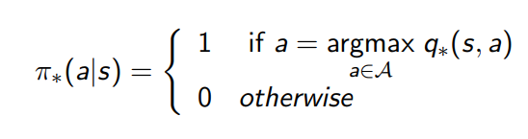
Optimal Value and Policy Functions
Finding an Optimal Policy
We find an optimal policy by maximizing over q*(s, a) i.e. our optimal state-action value function (or q-function).
We solve q*(s,a) and then we pick the action that gives us most optimal state-action value function. This statement can be expressed as:

Slide 36
Optimal Value and Policy Functions
Finding an Optimal Policy
What this says is that for a state s we pick the action a with probability 1, if it gives us the maximum q*(s,a). So, if we know q*(s,a) we can get an optimal policy from it. Let’s understand it with an example :

Slide 37
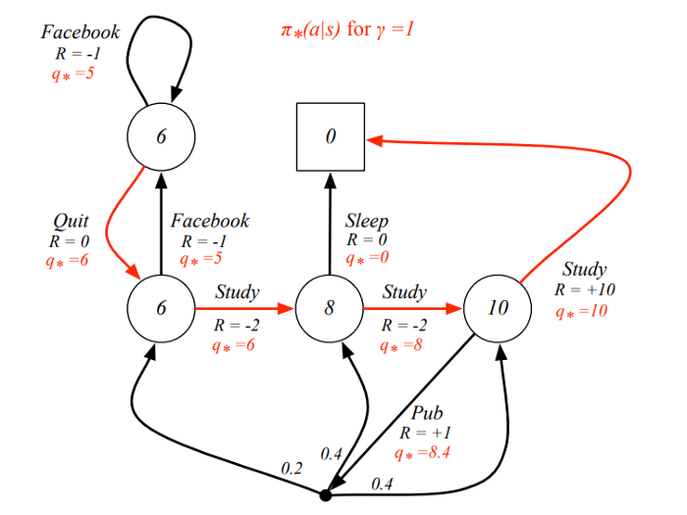
Optimal Value and Policy Functions

Slide 38
Optimal Value and Policy Functions
Finding an Optimal Policy
In this example, the red arcs are the optimal policy. Optimal policy always takes action with higher q* value.
For example, in the state with value 8, there is q* with value 0 and 8. Our agent chooses the one with greater q* value i.e. 8.
Now, the question arises, How do we find these q*(s,a) values? This is where Bellman Optimality Equation comes into play.

Slide 39
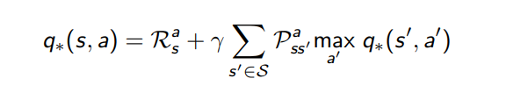
Bellman Optimality Equation
Bellman Optimality equation is the same as Bellman Expectation Equation but the only difference is instead of taking the average of the actions our agent can take we take the action with the max value.
Mathematically, this can be expressed as :
Now, how do we solve Bellman Optimality Equation for large MDPs. In order to do so we use Dynamic Programming algorithms like Policy iteration, Value iteration and Q-Learning are used.

Slide 40
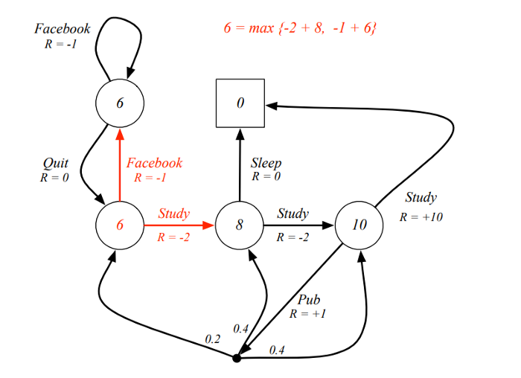
Bellman Optimality Equation

Slide 41
Value and Policy Iterations
There are two efficient algorithms for solving finite-state MDPs: Value iteration and policy iteration.
Value iteration computes the optimal state value function by iteratively improving the estimate of V(s).
The algorithm initialize V(s) to arbitrary random values. It repeatedly updates the P_{sa} and V(s) values until they converges.
Value iteration is guaranteed to converge to the optimal values.

Slide 42
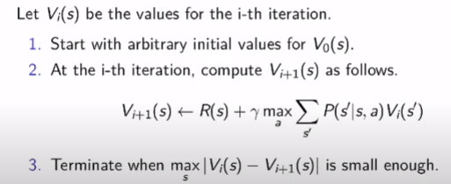
Value and Policy Iterations
Pseudocode for value iteration

Slide 43
Value and Policy Iterations
Since the agent only cares about the finding the optimal policy, sometimes the optimal policy will converge before the value function.
Therefore, another algorithm called policy-iteration instead of value iteration is used.
It re-defines the policy at each step and compute the value according to this new policy until the policy converges.
Policy iteration is also guaranteed to converge to the optimal policy and it often takes less iterations to converge than the value-iteration algorithm.

Slide 44
Value and Policy Iterations
Pseudocode of Policy Iteration
Initialize Π randomly
Evaluate a given policy by calculating value function for all states s ∊ S under the given policy
Improve policy : find a better action for state s ∊ S
Repeat step 2 and 3 until policy convergence.

Slide 45
Value Iteration Example
Consider the following Grid world problem.
Reward of entering a non-goal state: -0.04
Transition probability in intended direction: 0.8
Transition probabilities in Left/Right direction:0.1/0.1
Discount Factor (γ)=1
1
2
1
+1
2
-1

Slide 46
Value Iteration Example
Solution
Initial State:
s₁₁= -0.04+1*max{0.8*(+1)+0.1*0+0.1*0, (right)
0.8*0+0.1*0+0.1*0, (left)
0.8*0+0.1*(+1)+0.1*0,(up)
0.8*0+0.1*(+1)+0.1*0,(down)}
= -0.04+1*0.8=0.76
1
2
1
0
+1
2
0
-1

Slide 47
Value Iteration Example
Solution
s₂₁= -0.04+1*max{0.8*(-1)+0.1*0+0.1*0, (right)
0.8*0+0.1*0+0.1*0, (left)
0.8*0+0.1*(-1)+0.1*0,(up)
0.8*0+0.1*(-1)+0.1*0,(down)}
= -0.04+1*0=-0.04

Slide 48
Value Iteration Example
Solution
State (s₁)=
Similarly, Calculate s₂, s₃…..until convergence.
Then use greedy approach to find path.
1
2
1
0.76
+1
2
-0.04
-1

Slide 49
Policy Iteration Example
Consider the following Grid world problem.
Reward of entering a non-goal state: 0.04
Transition probability in intended direction: 0.8
Transition probabilities in Left/Right direction:0.1/0.1
Discount Factor (γ)=1
1
2
1
+1
2
-1

Slide 50
Policy Iteration Example
Solution
Initial Policy: Π(s₁₁)=Π(s₂₁)=right
Policy Evaluation
V(s₁₁)= -0.04+0.8*(+1)+0.1*V(s₁₁)+0.1*V(s₂₁)
V(s₂₁)= -0.04+0.8*(-1)+0.1*V(s₁₁)+0.1*V(s₂₁)
Solving these two equations we get,
V(s₁₁)=0.75 V(s₂₁)=-0.85
1
2
1
0
+1
2
0
-1

Slide 51
Policy Iteration Example
1
2
Solution
Policy Improvement
Π(s₁₁)=max{0.8*(+1)+0.1*0.75+0.1*(-0.85), (Right)
0.8*0.75+0.1*0.75+0.1*(-0.85), (Left)
0.8*0.75+0.1*(+1)+0.1*0.75, (Up)
0.8*(-0.85)+0.1*(+1)+0.1*0.75 (Down)}=Right
1
0.75
+1
2
-0.85
-1

Slide 52
Policy Iteration Example
Solution
Policy Improvement
Π(s₂₁)=max{0.8*(-1)+0.1*0.75+0.1*(-0.85), (Right)
0.8*(-0.85)+0.1*0.75+0.1*(-0.85), (Left)
0.8*0.75+0.1*(-1)+0.1*(-0.85), (Up)
0.8*(-0.85)+0.1*(-1)+0.1*(-0.85) (Down)}=Up
Repeat This process until policy convergence
1
2
1
2
1
Right
+1
1
Right
+1
2
Right
-1
2
Up
-1

